Slide 1

UdS_OP: Universal Desktop Software Operator
Bringing LLMs Beyond the Chat Window

Slide 2
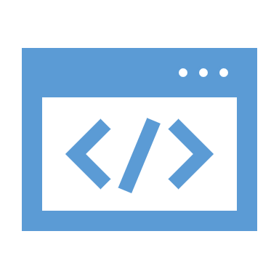
Description
Our application allows LLMs to take full control of the computer's user interface with a simple prompt, from managing files to performing online operations.

Slide 3
Challenges
All existing LLMs from major companies (OpenAI, Anthropic, etc.) are limited to a restricted text-based interface.
For many people, interacting with computers is still not intuitive.

Slide 4
Key Functions
File Management: Access and manipulate local files
Web App Generation: Create functional web apps from a short description
Automated Web Actions: Perform online operations

Slide 5
Features
Tasks are completed in under one minute.
No advanced prompt engineering required – the system asks for missing details automatically.

Slide 6

Demo

